Slide 1

Ultrasonic vibrations in metallurgy…
www.UltrasonicMetallurgy.com
US Casting proposal
MP Interconsulting
Marais 36,
2400 Le Locle, Switzerland
www.UltrasonicsWorldGroup.com
Phone: +41-32-9314045
Fax: +41-32-9314079
www.mpi-ultrasonics.com
mpi@mpi-ultrasonics.com

Slide 2
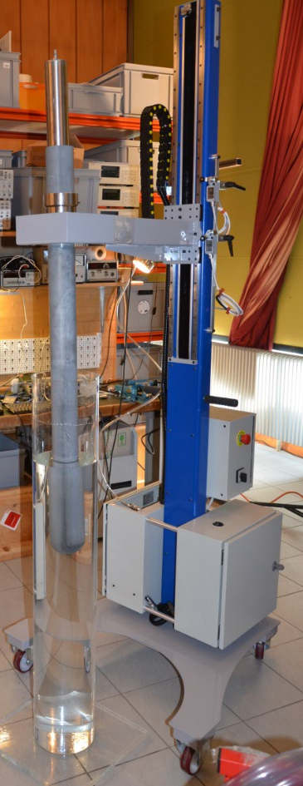
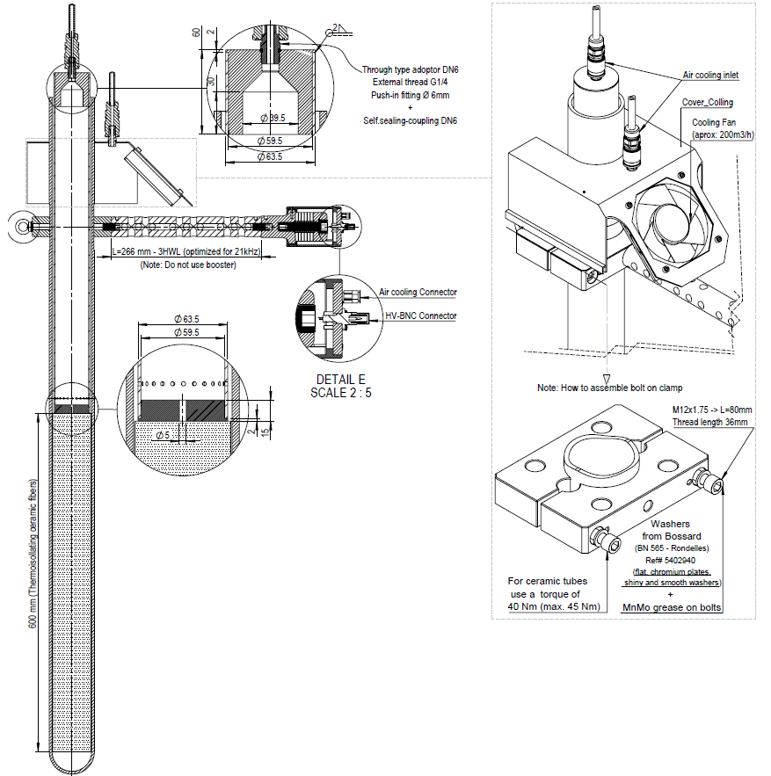
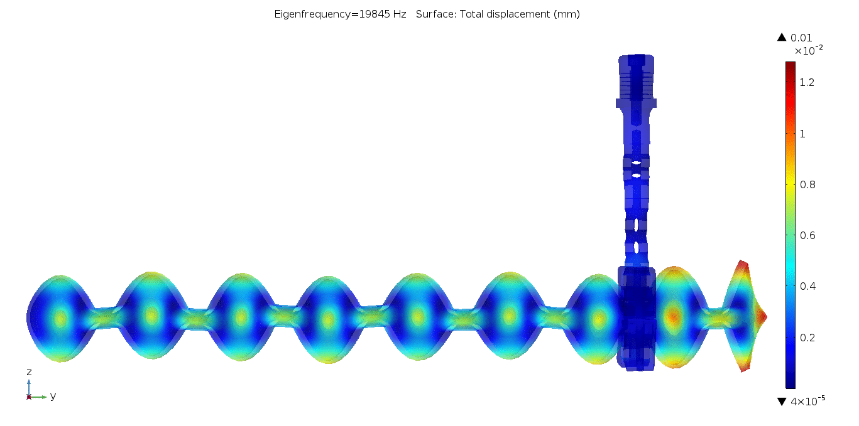
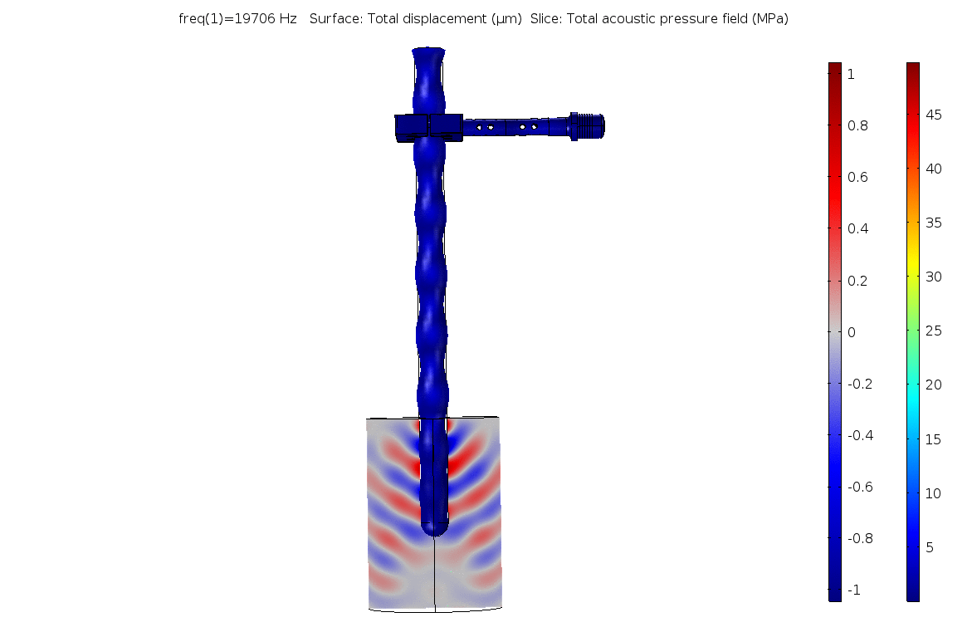
Ultrasonic System + Lift
©2001-20 MP Interconsulting, mpi@mpi-ultrasonics.com

Slide 3
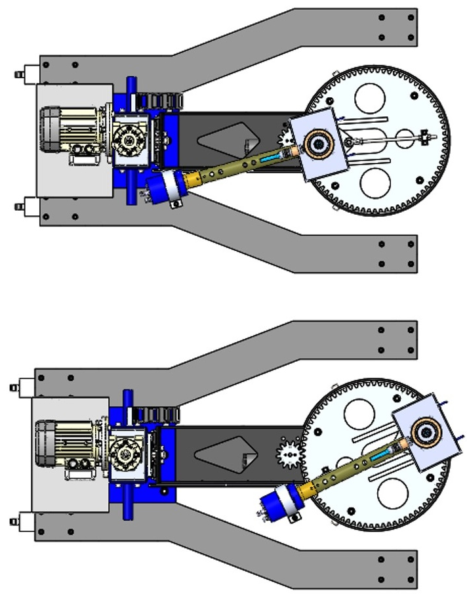
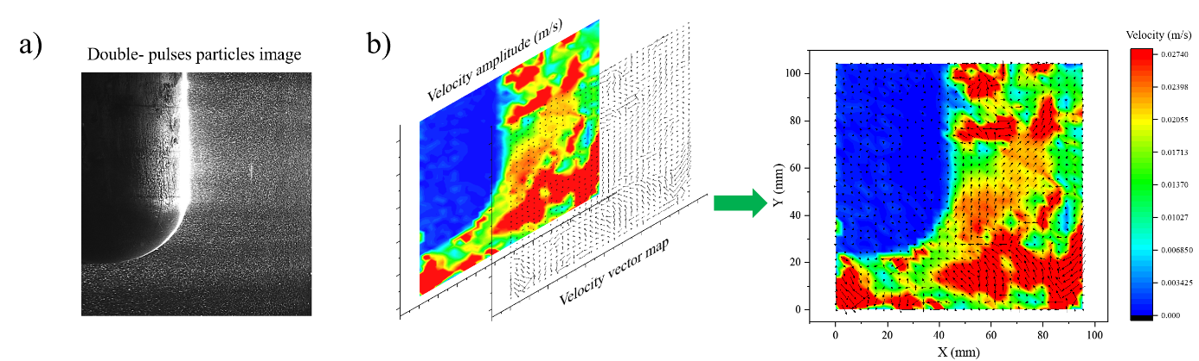
Spatial distribution of acoustic flow from the transducer radial sonication of SiAlON tube.
©2001-20 MP Interconsulting, mpi@mpi-ultrasonics.com

Slide 4
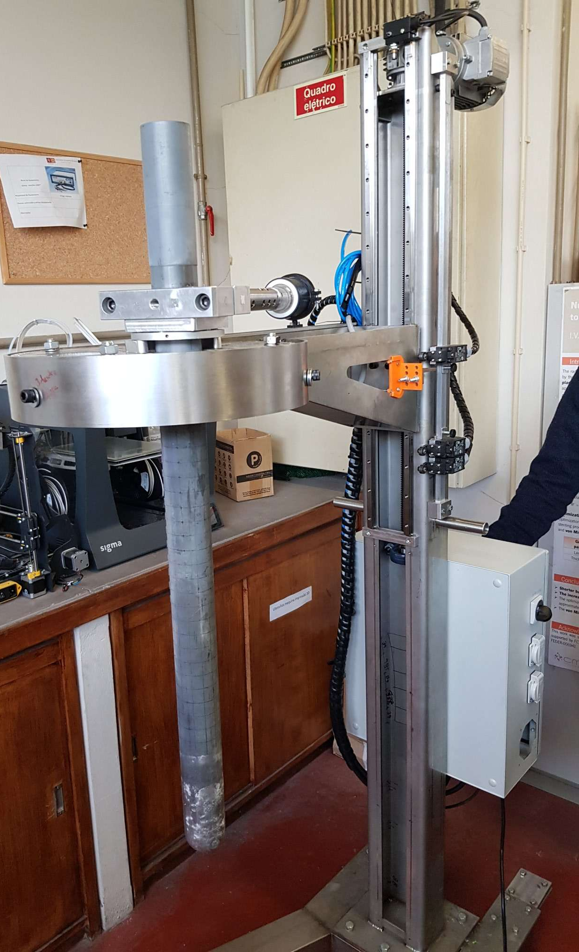
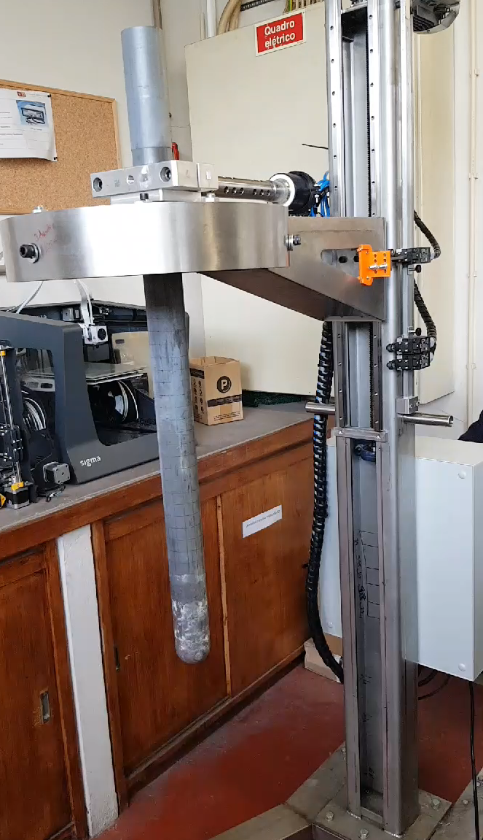
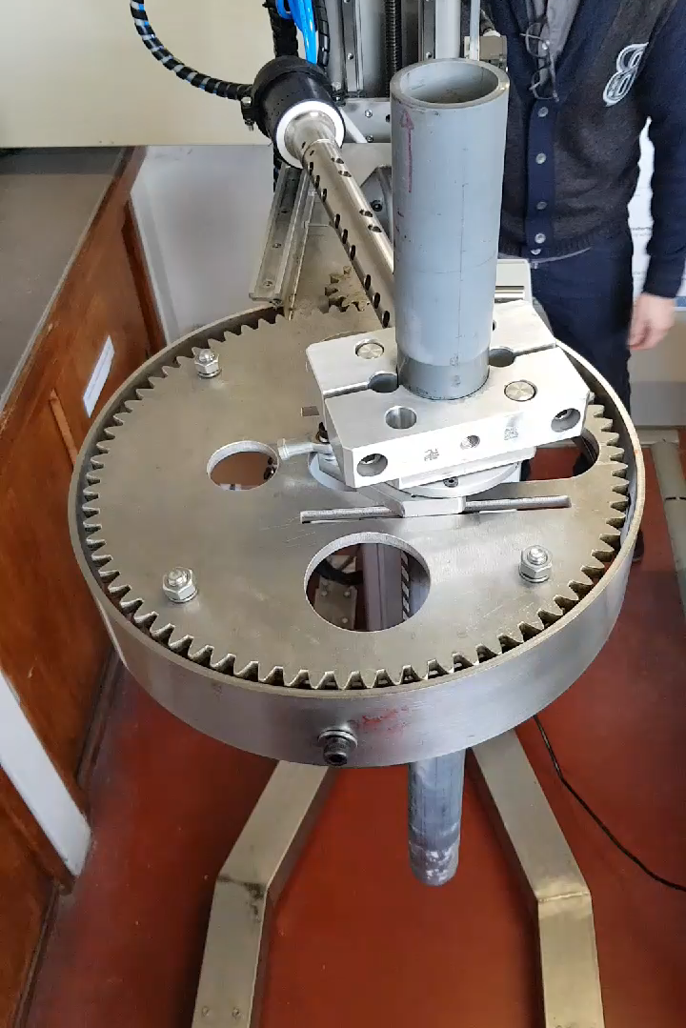
Ultrasonic System + Lift
©2001-20 MP Interconsulting, mpi@mpi-ultrasonics.com

Slide 5
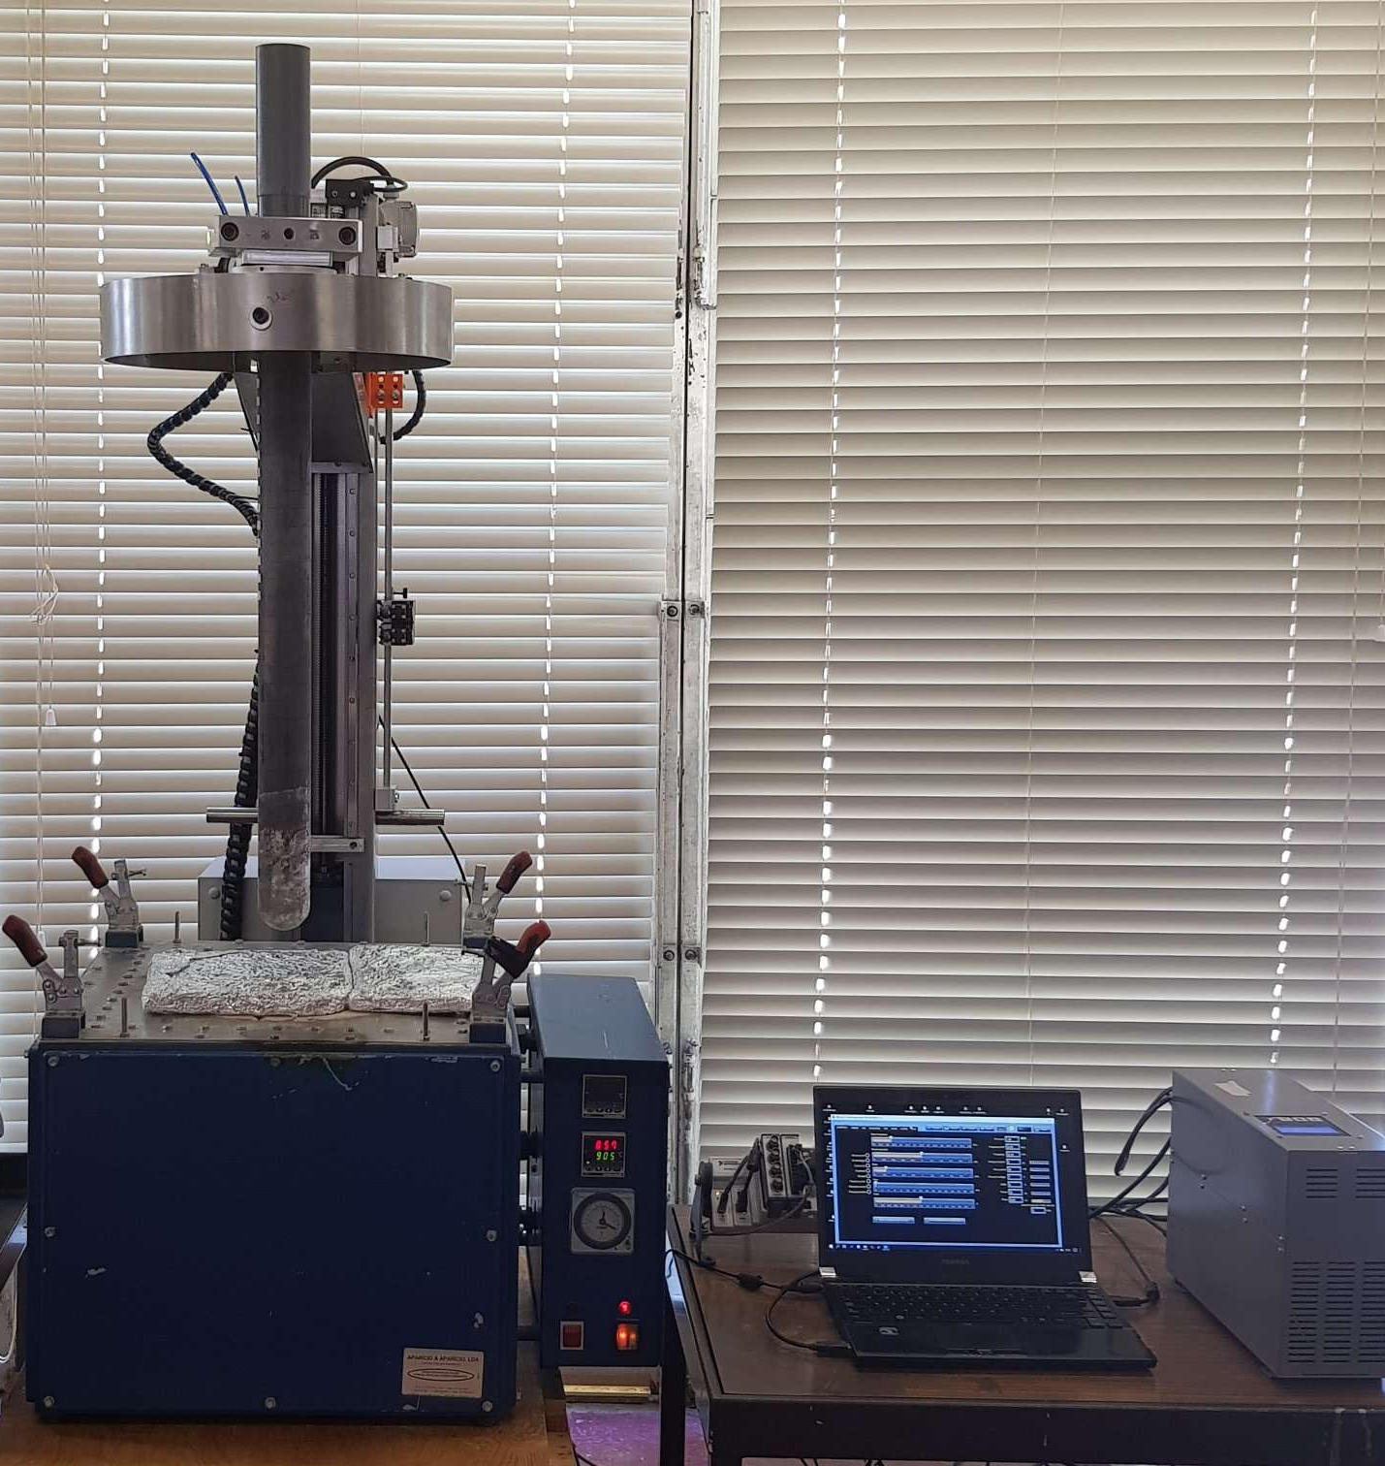
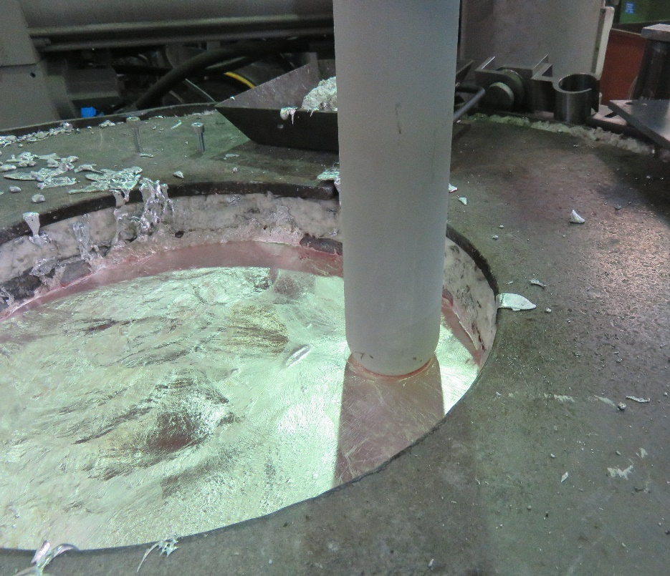
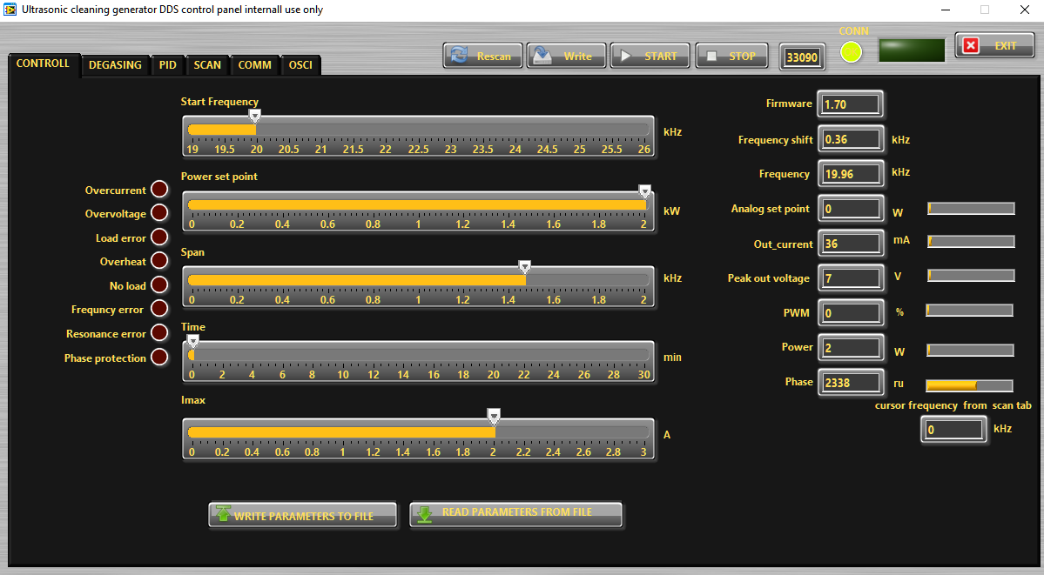
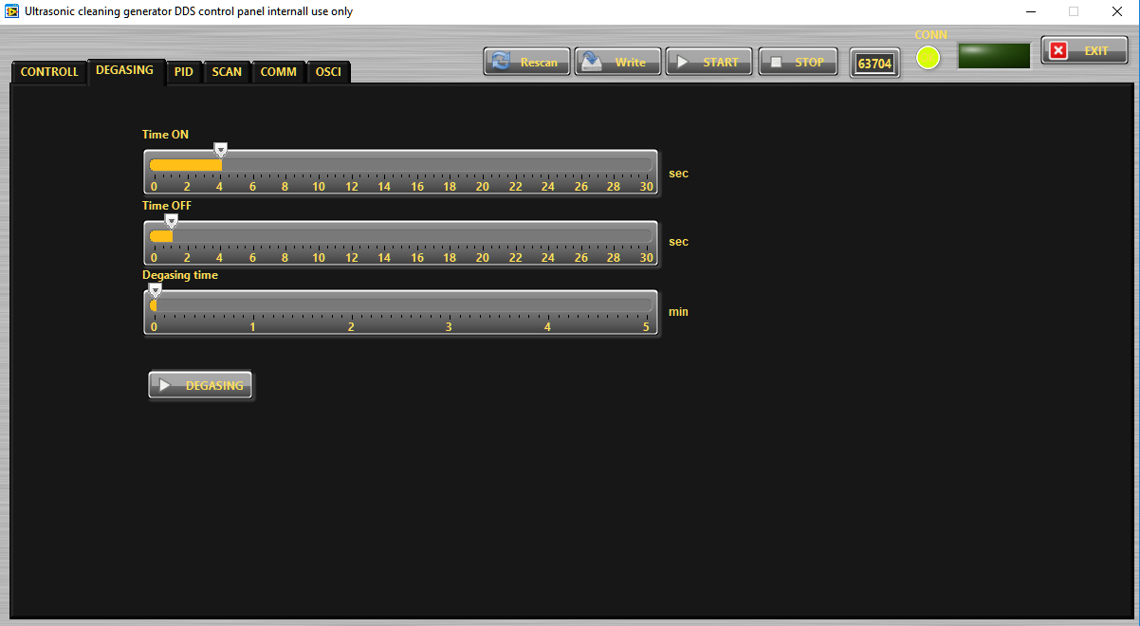
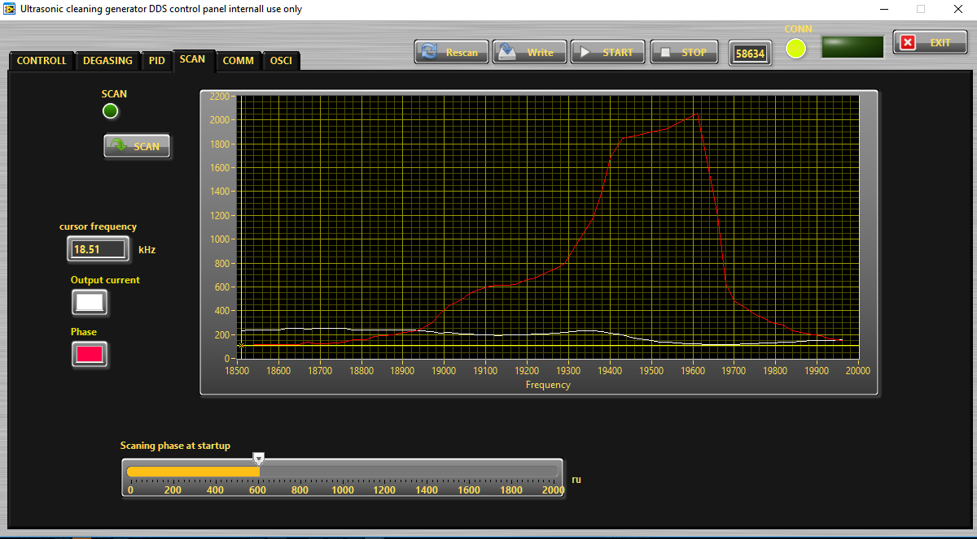
MPI dedicated Software Control
©2001-20 MP Interconsulting, mpi@mpi-ultrasonics.com

Slide 6
Thank You.
www.UltrasonicMetallurgy.com
MP Interconsulting
Marais 36,
2400 Le Locle, Switzerland
www.UltrasonicsWorldGroup.com
Phone: +41-32-9314045
Fax: +41-32-9314079
www.mpi-ultrasonics.com
mpi@mpi-ultrasonics.com

